Slide 1



JAX-RS
RESTful Web Services
www.supinfo.com
Copyright © SUPINFO. All rights reserved
Notes:
© SUPINFO International University - http://www.supinfo.com
SUPINFO vous permet de partager ce document
Vous êtes libre de :
Partager — reproduire, distribuer et communiquer ce document Remixer — modifier ce document
A condition de respecter les règles suivantes :
Indication obligatoire de la paternité — Vous devez obligatoirement préciser l’origine « SUPINFO » du document au début de celui-ci de la même manière qu’indiqué par SUPINFO International University – Notamment en laissant obligatoirement la première et la dernière page du document, mais pas d'une manière qui suggérerait que SUPINFO International University vous soutiennent ou approuvent votre utilisation du document, surtout si vous le modifiez. Dans ce dernier cas, il vous faudra obligatoirement supprimer le texte « SUPINFO Official Document » en tête de page et préciser notamment la page indiquant votre identité et les modifications principales apportées.
En dehors de ces dispositions, aucune autre modification de la première et de la dernière page du document n’est autorisée.
NOTE IMPORTANTE : Ce document est mis à disposition selon le contrat CC-BY-NC-SA Creative Commons disponible en ligne http://creativecommons.org/licenses ou par courrier postal à Creative Commons, 171 Second Street, Suite 300, San Francisco, California 94105, USA modifié en ce sens que la première et la dernière page du document ne peuvent être supprimées en cas de reproduction, distribution, communication ou modification. Vous pouvez donc reproduire, remixer, arranger et adapter ce document à des fins non commerciales tant que vous respectez les règles de paternité et que les nouveaux documents sont protégés selon des termes identiques. Les autorisations au-delà du champ de cette licence peuvent être obtenues à support@supinfo.com.
© SUPINFO International University – EDUCINVEST - Rue Ducale, 29 - 1000 Brussels Belgium . www.supinfo.com

Slide 2


Course objectives
JAX-RS
By completing this course, you will be able to:
Design RESTful Web Services
Use JAX-RS API

Slide 3

Course topics
JAX-RS
Course’s plan
HTTP reminders
RESTful Architectures
The JAX-RS API
JAX-RS with JAXB

Slide 4
HTTP Reminders
JAX-RS

Slide 5


The Protocol
HTTP Reminders
HyperText Transfer Protocol
Communications protocol developed for the Web
Request/Response protocol
Data transfer between a browser and a Web server
Stateless
Notes:
The HTTP protocol (HyperText Transfer Protocol), is a communication protocol client/server created for the Web. HTTP is use to transmit resources between clients (the Web browser) and the HTTP server (or Web server).

Slide 6
Request Message
HTTP Reminders
Composed of :
A request line composed of :
The request method used
The resource URI
The protocol and the version used
Headers
An empty line
An optional message body

Slide 7
Request Message
HTTP Reminders
POST /en/html/index.html HTTP/1.1
Host: www.website.com
User-Agent: Mozilla/5.0 (Windows;en-GB; rv:1.8.0.11)
Accept: text/xml,text/html;q=0.9,text/plain;q=0.8,image/png,*/*;q=0.5
Accept-Language: en-gb,en;q=0.5
Accept-Encoding: gzip,deflate
Accept-Charset: ISO-8859-1,utf-8;q=0.7,*;q=0.7
Keep-Alive: 300
Connection: keep-alive
Content-Type: application/x-www-form-urlencoded
Content-Length: 39
name=MyName&male=yes

Slide 8
Request Methods
HTTP Reminders
HTTP defines nine methods (or verbs) :
GET : Request a representation of the resource
POST : Submit data to be processed to the identified resource
This may result in the creation of a new resource
PUT : Uploads a representation of the specified resource
DELETE : Deletes the specified resource
…

Slide 9
Response Status Codes
HTTP Reminders
Status codes are divided into five classes :
1xx : Informational
Indicates a provisional response
2xx : Success
Indicates the request was received, understood, accepted and processed successfully
Examples :
200 OK
201 Created

Slide 10
Response Status Codes
HTTP Reminders
Status codes are divided into five classes :
3xx : Redirection
Indicates that further action needs to be taken by the user agent in order to fulfill the request
Example :
301 Moved Permanently

Slide 11
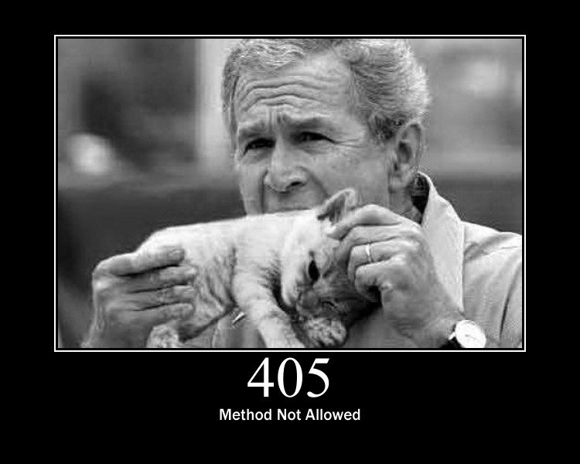
Response Status Codes
HTTP Reminders
Status codes are divided into five classes :
4xx : Client Error
Intended for cases in which the client seems to have erred
Examples :
403 Forbidden
404 Not Found
405 Method Not Allowed

Slide 12
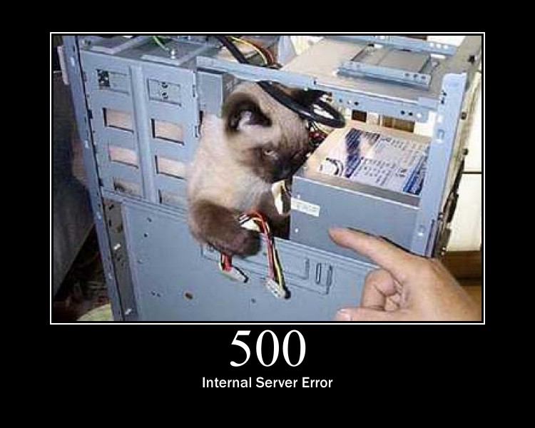
Response Status Codes
HTTP Reminders
Status codes are divided into five classes :
5xx : Server Error
Indicate the server is aware that it has encountered an error or is otherwise incapable of performing the request
Examples :
500 Internal Server Error
501 Not Implemented
502 Bad Gateway

Slide 13



Stop-and-think
HTTP Reminders
Do you have any questions ?
???

Slide 14
RESTful Architectures
JAX-RS

Slide 15
What is REST ?
RESTful Architectures
The term comes from Roy Fielding’s doctoral dissertation
REpresentational State Transfer
He defines a RESTful system with the following constraints :
It must be a client-server system
It has to be stateless
It has to support a caching system
It has to be uniformly accessible
It has to be layered (support scalability)
The static web is RESTful by default, not the dynamic one

Slide 16
Resources
RESTful Architectures
A RESTful resources is anything that is addressable over the Web
Resource examples are :
The temperature in Paris at 8:00 PM
A blog post
A list of Bug Reports inside a BTS
A search result in Google
Notes:
BTS: Bug Tracking System

Slide 17
Representation
RESTful Architectures
A Representation is typically a document that captures the current or intended state of a resource
It’s what is sent back and forth between clients and servers
Can take various form such as :
One resource can have more than one representation
HTML Document
Plain Text
XML Stream
JSON Stream
…

Slide 18
RESTful Web Services
RESTful Architectures
Also called RESTful web API, it’s a simple web service implemented using HTTP and the principles of REST
The URI of a resource is a hyperlink
The HTTP protocol provides methods on which we can map CRUD operations
And so apply different actions with the same URI !
Data action | HTTP protocol equivalent
CREATE | POST
RETRIEVE | GET
UPDATE | PUT
DELETE | DELETE

Slide 19

A simple RESTful example
RESTful Architectures
Example of RESTful Web Services with JAX-RS are available at the following URL :
http://restful-example.appspot.com/
It provides CRUD operations on a student list
We’ll use them as example in the course

Slide 20
GET / Retrieve
RESTful Architectures
The method GET is used to RETRIEVE resources
For instance, a GET request to the URI /students return all the students :
<students>
<count>2</count>
<student>
<birthDate>5287-09-15T22:00:13.524Z</birthDate>
<firstName>Jack</firstName>
<idBooster>59253</idBooster>
<lastName>Harkness</lastName>
</student>
<student>
<birthDate>1997-08-12T22:00:13.524Z</birthDate>
<firstName>Eric</firstName>
<idBooster>64543</idBooster>
<lastName>Cartman</lastName>
</student>
</students>

Slide 21

GET / Retrieve
RESTful Architectures
And a GET request to the URI /students/59253 returns Jack :
<student>
<birthDate>5287-09-15T22:00:13.524Z</birthDate>
<firstName>Jack</firstName>
<idBooster>59253</idBooster>
<lastName>Harkness</lastName>
</student>

Slide 22
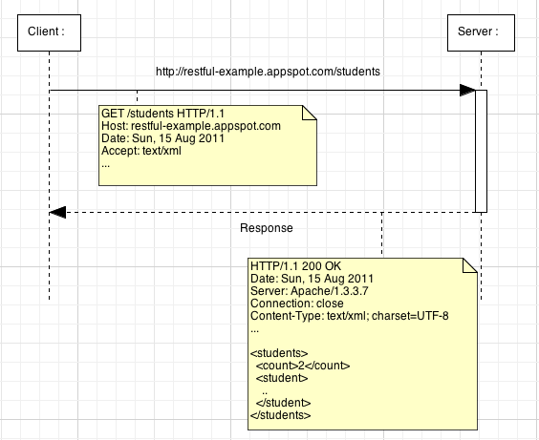
GET / Retrieve
RESTful Architectures
Let’s have a look at the request details :

Slide 23
POST / Create
RESTful Architectures
The method POST is used to CREATE resources
For instance, assume Joe doesn’t exist in our list and we want to add him :
A Joe XML representation looks like this :
<student>
<birthDate>1946-06-28T22:00:13.524Z</birthDate>
<firstName>Joe</firstName>
<idBooster>65442</idBooster>
<lastName>Dalton</lastName>
</student>

Slide 24
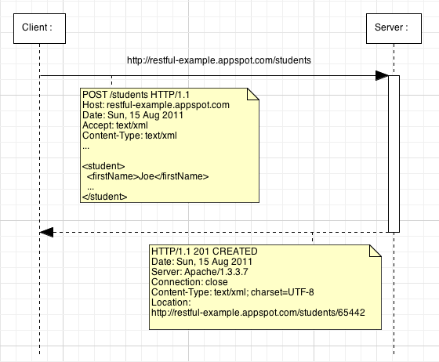
POST / Create
RESTful Architectures
Let’s have a look at the request details :
Notes:
The response of a POST request can contain a body but in that example we prefer use the 201 status code with a Location header with the new resource URI.

Slide 25
PUT / Update
RESTful Architectures
The method PUT is used to UPDATE resources
For instance, assume Joe representation is currently like that :
We want update him to be like this :
<student>
<birthDate>1946-06-28T22:00:13.524Z</birthDate>
<firstName>Joe</firstName>
<idBooster>65442</idBooster>
<lastName>Dalton</lastName>
</student>
<student>
<birthDate>1946-06-28T22:00:13.524Z</birthDate>
<firstName>Joeffrey</firstName>
<idBooster>65442</idBooster>
<lastName>Dalton</lastName>
</student>

Slide 26
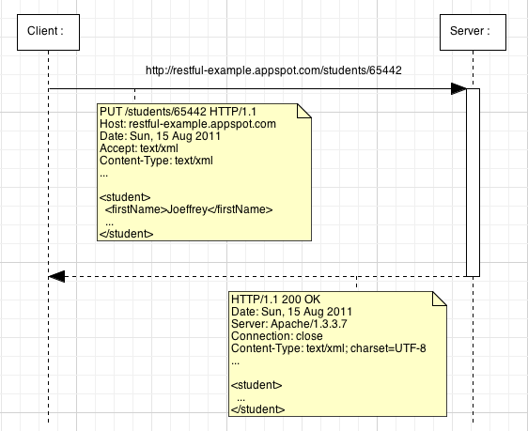
PUT / Update
RESTful Architectures
Let’s have a look at the request details :

Slide 27
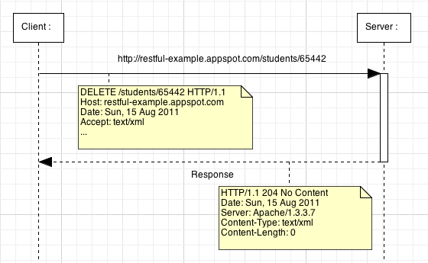
DELETE / Delete
RESTful Architectures
The method DELETE is used to DELETE resources
Let’s have a look at the request details :

Slide 28
Stop-and-think
RESTful Architectures
Do you have any questions ?
???

Slide 29
RESTful Architectures
Demonstration
Let’s see if the RESTful Web Services of http://restful-example.appspot.com/ work well !
Notes:
[Title of the course]
Nov 8, 2008
Copyright © 2004-2005 NameOfTheOrganization. All rights reserved.
29

Slide 30
JAX-RS API
JAX-RS

Slide 31
Presentation
JAX-RS API
JAX-RS is one of the Java EE specifications
A dedicated API to design REST Web Services !
As all Java EE specifications, more than one implementations are available :
Apache CXF, an open source Web Service framework
Jersey, the reference implementation from Sun / Oracle
RESTEasy, JBoss's implementation
For this course, we’ll use Jersey !
Libraries are available here : http://jersey.dev.java.net

Slide 32

Presentation
JAX-RS API
JAX-RS API objective is to make RESTful Web Service development very easy :
Just need to develop POJO (Plain Old Java Object)…
… enhanced by annotations !
No need to handle HTTP request at low level
Just concentrate on the business rules !
We’re going to see the main annotations JAX-RS provides…

Slide 33
Installation
JAX-RS API
To use Jersey, you have to :
Include libraries in your project
Define the Jersey Servlet in the Deployment Descriptor :
<servlet>
<servlet-name>Jersey Web Application</servlet-name>
<servlet-class>
com.sun.jersey.spi.container.servlet.ServletContainer
</servlet-class>
<init-param>
<param-name>
com.sun.jersey.config.property.packages
</param-name>
<param-value>com.supinfo.restfulexample.rest</param-value>
</init-param>
</servlet>
<servlet-mapping>
<servlet-name>Jersey Web Application</servlet-name>
<url-pattern>/resources/*</url-pattern>
</servlet-mapping>
Notes:
The init-param com.sun.jersey.config.property.packages define the package containing your JAX-RS Resource classes.
The servlet-mapping define for which url pattern Jersey have to do something.

Slide 34
Resource URI
JAX-RS API
A JAX-RS resource is a Java class with the @Path annotation to define his URI
Example :
This annotation can also be used to define variables in URIs :
We’ll see later how to retrieve the value of those variables
@Path("/students")
public class StudentsResource {
...
}
@Path("/students/{idBooster}")
public class StudentsResource {
...
}

Slide 35
HTTP methods
JAX-RS API
To determine which Java method to call in function of the HTTP method request, JAX-RS provide four annotations :
@GET
@POST
@PUT
@DELETE
Example :
@Path("/students")
public class StudentsResource {
@GET
public String handleGetRequest() { ... }
@POST
public String handlePostRequest(String payload) { ... }
}

Slide 36
HTTP methods
JAX-RS API
POST and PUT methods handler can have a payload parameter representing the request’s body data
Payloads can have several types in function of the Content-Type request header :
Java Type | Content Type Supported
java.lang.String | */*
byte[] | */*
java.io.InputStream | */*
java.io.Reader | */*
javax.ws.rs.core. MultivaluedMap<String, String> | application/x-www-form-urlencoded
JAXB classes | text/xml, application/xml, application/json
Notes:
We’ll see JAXB classes later…

Slide 37
Relative paths in methods
JAX-RS API
In some cases it may be useful to define two Java methods associated with two different URI in a same class
You can do that declaring @Path annotation on a method !
Example :
In that case, a GET request on /students/search/Jack will execute the searchStudent() method
@Path("/students")
public class StudentsResource {
@GET
public String getStudentList() { ... }
@GET @Path("/search/{query}")
public String searchStudent() { ... }
}

Slide 38
URI variables
JAX-RS API
We saw how to define variables with @Path annotation in previous slides…
… but no how to retrieve them inside a Java method
To do that, JAX-RS define a @PathParam annotation
You can use it as follow :
@GET @Path("/{idBooster}")
public String getStudent(@PathParam("idBooster") Long id) {
...
}
@GET @Path("/search/{query}")
public String searchStudent(@PathParam("query") String q) {
...
}

Slide 39
Input formats
JAX-RS API
We can define which method to call in function of the Content-Type HTTP header of the client request thanks to :
@Consumes annotation
Example :
@Path("/students")
public class StudentResource {
@POST @Consumes(MediaType.APPLICATION_XML)
public String addXmlStudent(String payload) { ... }
@POST @Consumes(MediaType.APPLICATION_JSON)
public String addJsonStudent(String payload) { ... }
}

Slide 40
Output formats
JAX-RS API
We can define which method to call in function of the Accept HTTP header of the client request thanks to :
@Produces annotation
Example :
@Path("/students")
public class StudentResource {
@GET @Produces(MediaType.APPLICATION_XML)
public String getStudentAsXml() { ... }
@GET @Produces(MediaType.APPLICATION_JSON)
public String getStudentAsJson() { ... }
}

Slide 41
Stop-and-think
JAX-RS API
Do you have any questions ?
???

Slide 42
JAX-RS API
Exercises (1/2)
Create a package com.supinfo.supcommerce.rest
Create a class ProductResource with the following methods :
getAllProductsInXml()
getAllProductsInJson()
getProductInXml(Long productId)
getProductInJson(Long productId)
removeProduct(Long productId)
Add the correct annotations to make this methods RESTful Web Services using JAX-RS !
Notes:
[Title of the course]
Nov 8, 2008
Copyright © 2004-2005 NameOfTheOrganization. All rights reserved.
42

Slide 43
JAX-RS API
Exercises (2/2)
The XML representation have to be like this :
And the JSON representation have to be like that :
<products>
<product>
<id>12</id>
<name>Product1</name>
<description>Description1</description>
<price>123.00</price>
</product>
...
</products>
{"products":[
{
"id":"12",
"name":"Product1",
"description":"Description1",
"price":"123.00"
}, {...}
]}
Notes:
[Title of the course]
Nov 8, 2008
Copyright © 2004-2005 NameOfTheOrganization. All rights reserved.
43

Slide 44
JAX-RS with JAXB
JAX-RS

Slide 45
Presentation
JAX-RS with JAXB
JAXB for Java Architecture for XML Binding
Allow to map Java classes to XML representations
Two main features are :
Marshal Java objects into XML
Unmarshal XML into Java objects
Very useful for Web Services !
This course isn’t about all the JAXB features
We’re going to see only one part in order to make REST Web Services development easier !

Slide 46

JAX-RS and JAXB support
JAX-RS with JAXB
Jersey provides a very helpful integration of JAXB including the following features :
Serialize Java objects as JSON document
Unserialize JSON document into Java objects
Automatic Unserialization of resource method payloads
No more need to define one method by consume type !
Automatic Serialization of resource method results
No more need to define one method by produce type !

Slide 47
JAX-RS and JAXB support
JAX-RS with JAXB
Example :
@Path("/students")
public class StudentResource {
@GET @Path("/{idBooster}")
public Student getStudent(@PathParm("idBooster") Long id) {
Student student = ... ; //Retrieve Student in DB
return student;
}
@POST
public Response addStudent(Student student) {
... ; //Add the student in DB
String studentUri = "/" + student.getIdBooster();
return Response.created(URI.create(studentUri)).build();
}
}

Slide 48

Annotations
JAX-RS with JAXB
Since JAXB2, you can map a Java class just with annotations ! (yeah, annotations again…)
We’re going to see the main ones :
@XmlRootElement
@XmlElement
@XmlAttribute
@

Slide 49
XmlRootElement
JAX-RS with JAXB
Maps a class or an enum type to an XML top-level element
By default the name of the XML element is the same than the class name
But you can change it thanks to the name attribute of the annotation
Example :
@XmlRootElement(name="doc")
public class Document {
}

Slide 50
XmlElement
JAX-RS with JAXB
Maps a JavaBean property to an XML element derived from property name
This annotation is optionnal
Three annotation attributes are available :
name : the name of the XML element
required : specify if the element is optional or nillable
defaultValue : default value of this element
Example :
@XmlElement(name = ”first-name", required = true)
private String firstName;

Slide 51
XmlAttribute
JAX-RS with JAXB
Maps a JavaBean property to an XML attribute
Two annotation attributes are available :
name : the name of the XML element
required : specify if the element is optional or nillable
Example :
@XmlAttribute
private int score;

Slide 52
Examples
JAX-RS with JAXB
@XmlRootElement
public class User {
private String username;
private String firstName;
private String lastName;
// Getters and Setters
}
<?xml version="1.0" encoding="UTF-8" standalone="yes"?>
<xs:schema version="1.0" xmlns:xs="...">
<xs:element name="user" type="user"/>
<xs:complexType name="user">
<xs:sequence>
<xs:element name="firstName" type="xs:string" minOccurs="0"/>
<xs:element name="lastName" type="xs:string" minOccurs="0"/>
<xs:element name="username" type="xs:string" minOccurs="0"/>
</xs:sequence>
</xs:complexType>
</xs:schema>

Slide 53
Examples
JAX-RS with JAXB
@XmlRootElement
public class User {
// Attributes
@XmlAttribute(name="id-booster")
public Long getIdBooster() { return idBooster; }
@XmlElement(name="first-name")
public String getFirstName() { return firstName; }
@XmlElement(name="last-name")
public String getLastName() { return lastName; }
// Setters
}

Slide 54
Examples
JAX-RS with JAXB
<?xml version="1.0" encoding="UTF-8" standalone="yes"?>
<xs:schema version="1.0" xmlns:xs="...">
<xs:element name="user" type="user"/>
<xs:complexType name="user">
<xs:sequence>
<xs:element name="first-name" type="xs:string" minOccurs="0"/>
<xs:element name="last-name" type="xs:string" minOccurs="0"/>
</xs:sequence>
<xs:attribute name="id-booster" type="xs:long"/>
</xs:complexType>
</xs:schema>

Slide 55
Stop-and-think
JAX-RS with JAXB
Do you have any questions ?
???

Slide 56
JAX-RS with JAXB
Exercises (1/2)
Add the JAXB libraries to your application
Update your entities with the JAXB annotations you need
Refactor your web service methods to use JAXB !
Notes:
[Title of the course]
Nov 8, 2008
Copyright © 2004-2005 NameOfTheOrganization. All rights reserved.
56

Slide 57
JAX-RS with JAXB
Exercises (2/2)
Create a new class CategoryResource with the following methods :
addCategory(Category category)
getCategory(Long categoryId)
Must return the category with all its products
updateCategory(Category category)
Add the correct annotations to make this methods RESTful Web Services using JAX-RS !
Notes:
[Title of the course]
Nov 8, 2008
Copyright © 2004-2005 NameOfTheOrganization. All rights reserved.
57

Slide 58

Course summary
JAX-RS
RESTful Architecture
REST over HTTP
JAX-RS API
Use JAXB with JAX-RS

Slide 59

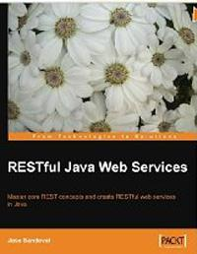
JAX-RS
For more
If you want to go into these subjects more deeply, …
Publications
RESTful Java Web Services
Master core REST concepts and create RESTful web services in Java
Jose SANDOVAL
PACKT Editions
Web sites
http://restful-example.appspot.com/
http://jersey.java.net/
www.touilleur-express.fr/2008/04/25/jsr-311-jax-rs-rest-une-histoire-de-restaurant/

Slide 60


The end
JAX-RS

